Slide 1
Regression
Unit 02 Lecture 06
Dr. Muhammad Ismail Mangrio

Slide 2
Contents
Simple Linear Regression
  The Regression Equation
  Fitted Values and Residuals
  Least Squares
Multiple Linear Regression
  Example: King County Housing Data
  Assessing the Model
  Cross-Validation

Slide 3
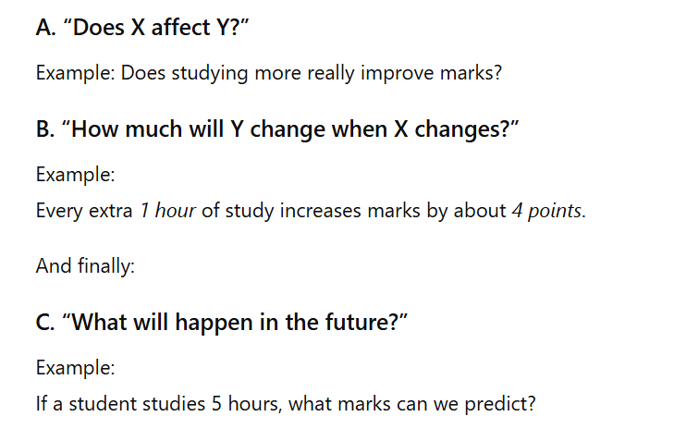
Why Do We Need Regression?
Regression find the relationship between variables and make predictions.

Slide 4
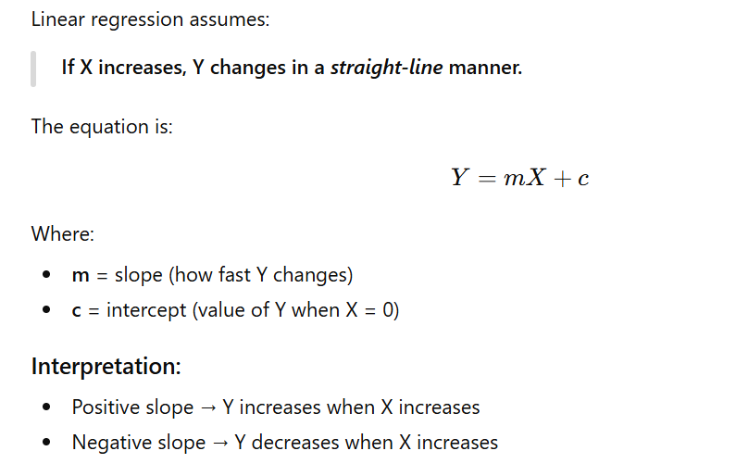
Regression

Slide 5
Regression
A regression is a statistical technique that relates a dependent variable to one or more independent variables.
The most common goal in statistics is to answer the question
  Is the variable X associated with a variable Y, and if so,
  what is the relationship and can we use it to predict Y?
This process of training a model on data where the outcome is known, for subsequent application to data where the outcome is not known, is termed supervised learning.
Typically, a regression analysis is done for one of two purposes:
  In order to predict the value of the dependent variable for individuals for whom some information concerning the explanatory variables is available, or
  in order to estimate the effect of some explanatory variable on the dependent variable

Slide 6
Regression
Dependent variable: Whose values depend on the other variables
Independent variable: Who forms the basis of estimation
Independent variables | Dependent variables
Income | Expenditure
Height of the parents | Heights of the children
My study hours | Marks in exams

Slide 7
Simple Linear Regression
Simple linear regression provides a model of the relationship between the magnitude of one variable and that of a second—for example, as X increases, Y also increases. Or as X increases, Y decreases.
Correlation is another way to measure how two variables are related.
The difference between regression and correlation is:
  Correlation measures the strength of an association between two variables.
  Regression quantifies the nature of the relationship.
Simple linear regression estimates how much Y will change when X changes by a certain amount. With the correlation coefficient, the variables X and Y are inter‐changeable.

Slide 8
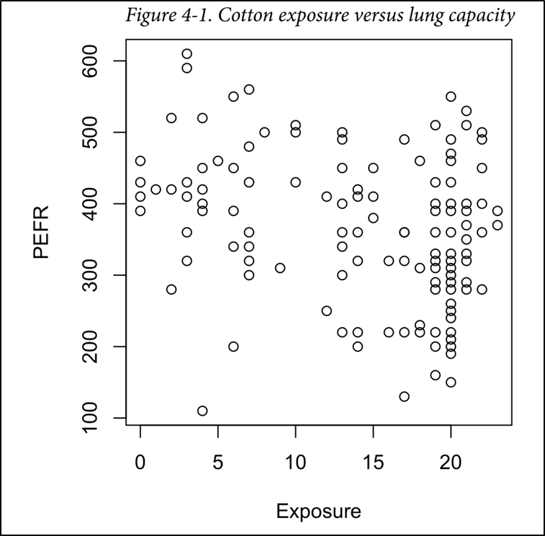
Simple Linear Regression(The Regression Equation)
With regression, we are trying to predict the Y variable from X using a linear relationship (i.e., a line):
𝑦=𝑏0+𝑏1𝑋
The symbol b0 is known as the intercept (or constant), and the symbol b1 as the slope for X or regression coefficient.
  b0 is the value of dependent when independent variable value is zero
  b1 tells the rate change in dependent variable with unit change in independent variable
The Y variable is known as the response or dependent variable since it depends on X.
The X variable is known as the predictor or independent variable.
The machine learning community tends to use other terms, calling Y the target and X a feature vector.

Slide 9
Simple Linear Regression(The Regression Equation)
Consider the scatterplot in Figure 4-1 displaying the number of years a worker was exposed to cotton dust (Exposure) versus a measure of lung capacity (PEFR or “peak expiratory flow rate”).
How is PEFR related to Exposure?
It’s hard to tell based just on the picture.
Simple linear regression tries to find the “best” line to predict the response PEFR as a function of the predictor variable Exposure:
  PEFR = b0 + b1 Exposure

Slide 10
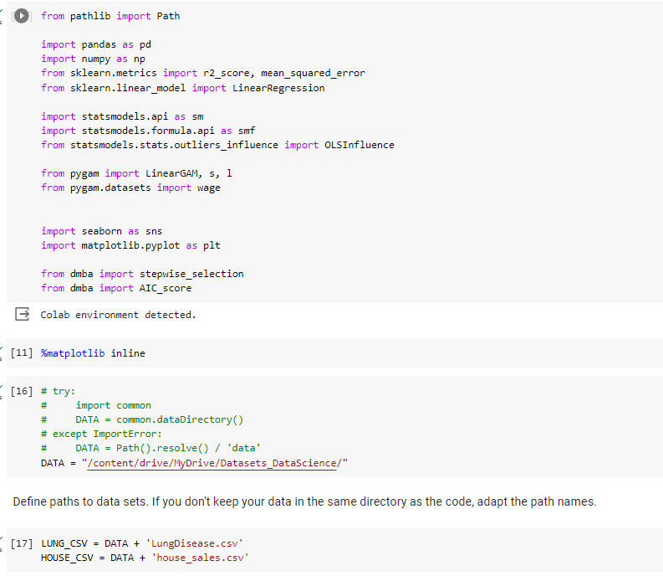
Colab code for regression
First install pre-requisite libraries
  pip install dmba
  pip install pygam

Slide 11
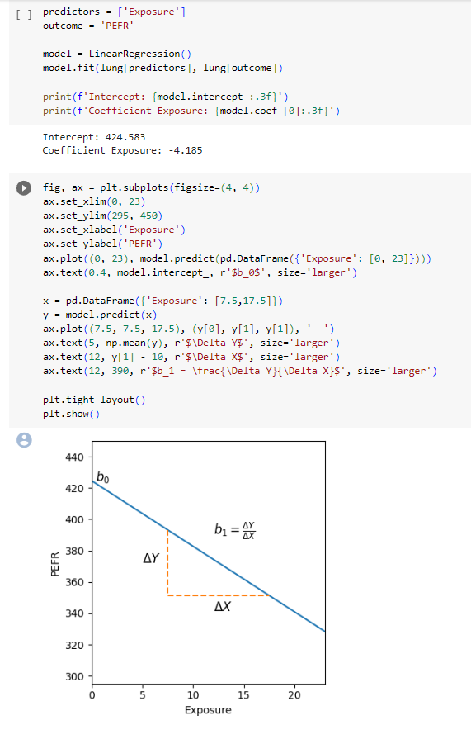
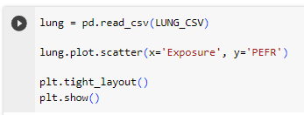
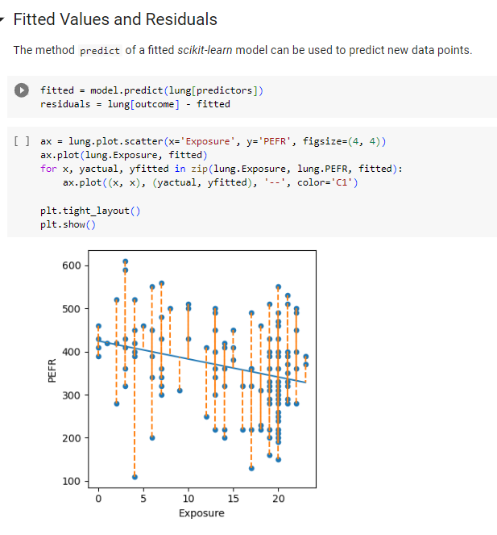
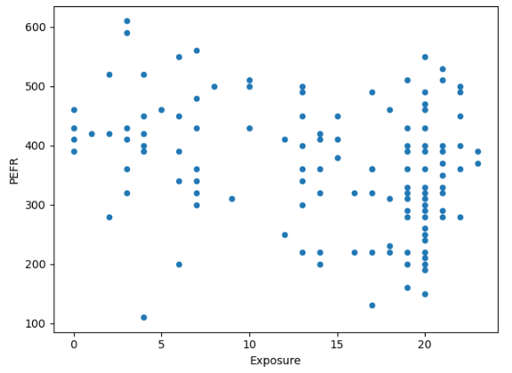
Colab code for regression
The intercept, or b0, is 424.583 and can be interpreted as the predicted PEFR for a worker with zero years exposure. The regression coefficient, or b1, can be interpreted as follows: for each additional year that a worker is exposed to cotton dust, the worker’s PEFR measurement is reduced by –4.185.

Slide 12


Simple Linear Regression (Fitted Values and Residuals)
Important concepts in regression analysis are the fitted values (the predictions) and residuals (prediction errors).
In general, the data doesn’t fall exactly on a line, so the regression equation should include an explicit error term e_{i} :
  𝑌𝑖=𝑏0+𝑏1𝑋𝑖+𝑒𝑖
The fitted values are typically denoted by (Y-hat). These are given by:
The notation (𝑏0) ̅ and 𝑏 ̅1 indicates that the coefficients are estimated versus known.
We compute the residuals ei by subtracting the predicted values from the original data:
0

Slide 13
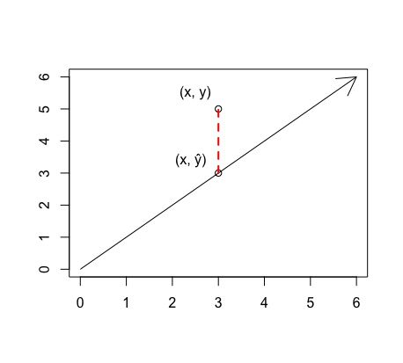


Simple Linear Regression (Fitted Values and Residuals)
Residuals: Let's take a moment to notice the little gap between the observed y-value (the scatter point labelled y) and the predicted y-value (the point on the line labelled yˆ). This gap is called the residual.
Definition: The residual is the vertical distance between the observed point and your predicted y-value.
Notes:
Fitted Y (Predicted Marks)

Slide 14
Simple Linear Regression (Fitted Values and Residuals)
Residuals tell us how far off the model’s prediction is for each data point.
Small residuals → model fits well
Large residuals → model does not fit that point well
X (Hours) | Actual Y | Fitted Y | Residual (Y - Ŷ)
1 | 52 | 49.5 | 2.5
2 | 56 | 54.0 | 2.0
3 | 61 | 58.5 | 2.5
Notes:
Fitted Y (Predicted Marks)

Slide 15
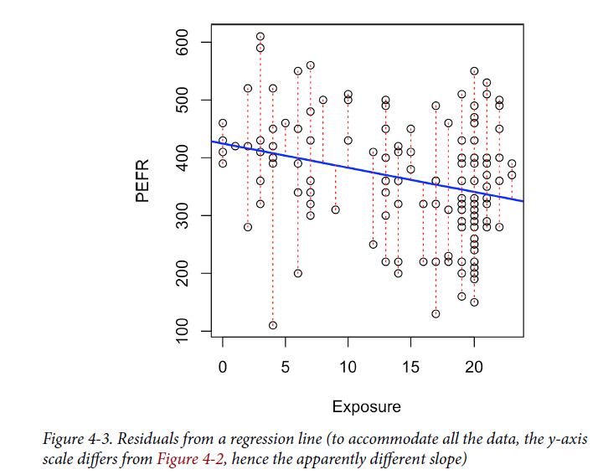
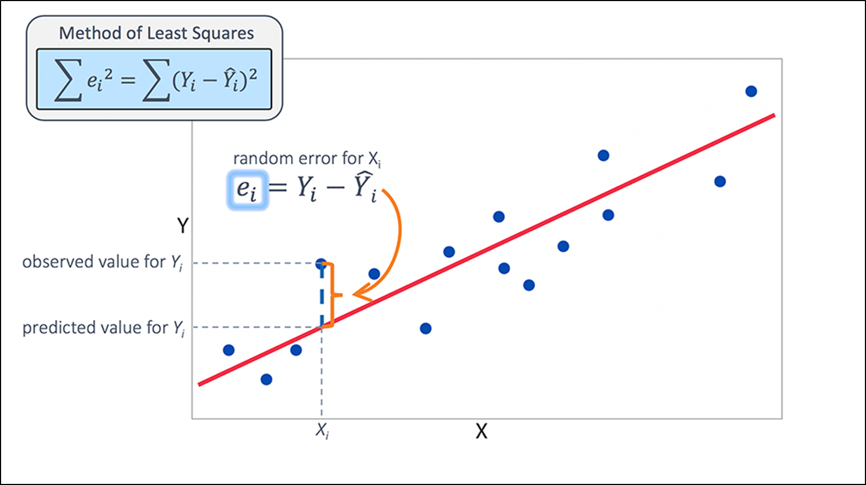
Simple Linear Regression(Fitted Values and Residuals)
Figure 4-3 illustrates the residuals from the regression line fit to the lung data.
The residuals are the length of the vertical dashed lines from the data

Slide 16
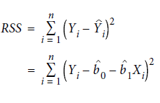
Simple Linear Regression(Least Squares)
How is the model fit to the data?
When there is a clear relationship, you could imagine fitting the line by hand.
In practice, the regression line is the estimate that minimizes the sum of squared residual values, also called the residual sum of squares or RSS:

Slide 17
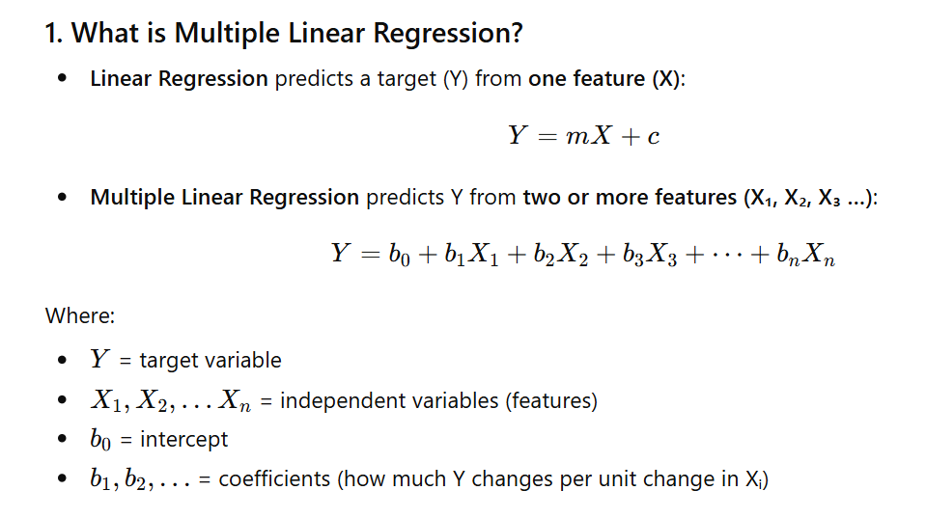
Multiple Linear Regression

Slide 18


Multiple Linear Regression
When there are multiple predictors, the equation is simply extended to accommodate them:
Instead of a line, we now have a linear model—the relationship between each coefficient and its variable (feature) is linear.
All of the other concepts in simple linear regression, such as fitting by least squares and the definition of fitted values and residuals, extend to the multiple linear regression setting.
For example, the fitted values are given by:

Slide 19

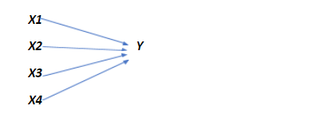
Multiple Linear Regression
Simple linear regression
Multiple regression

Slide 20
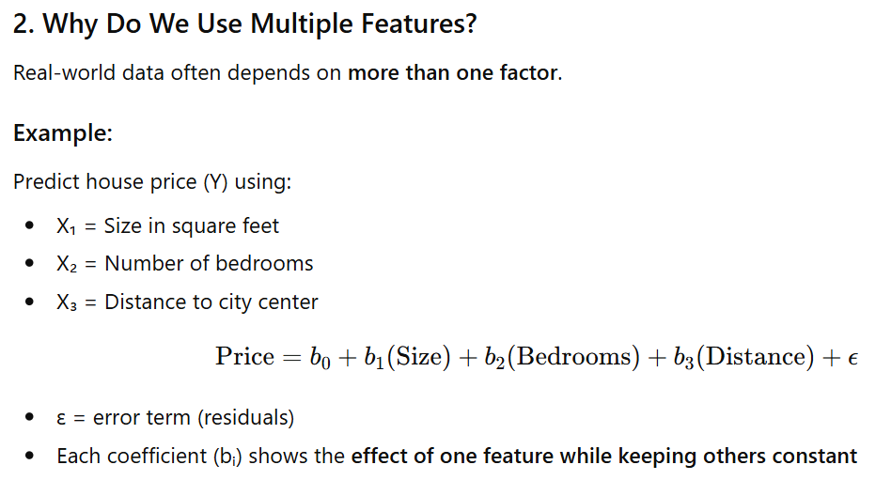
Multiple Linear Regression

Slide 21
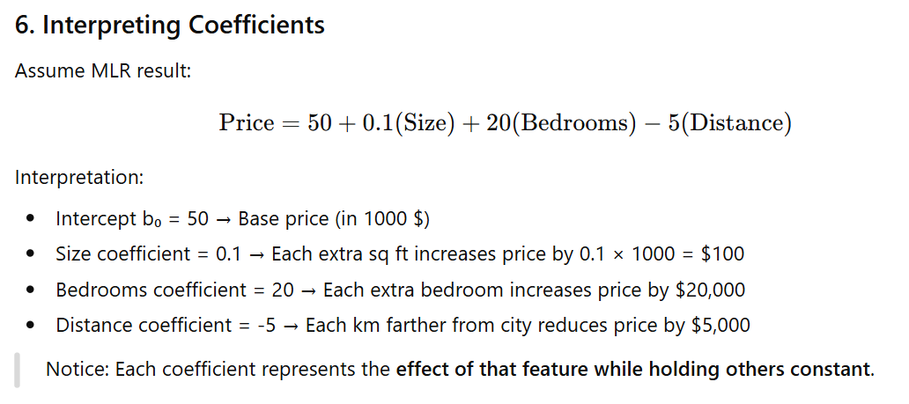
Multiple Linear Regression

Slide 22
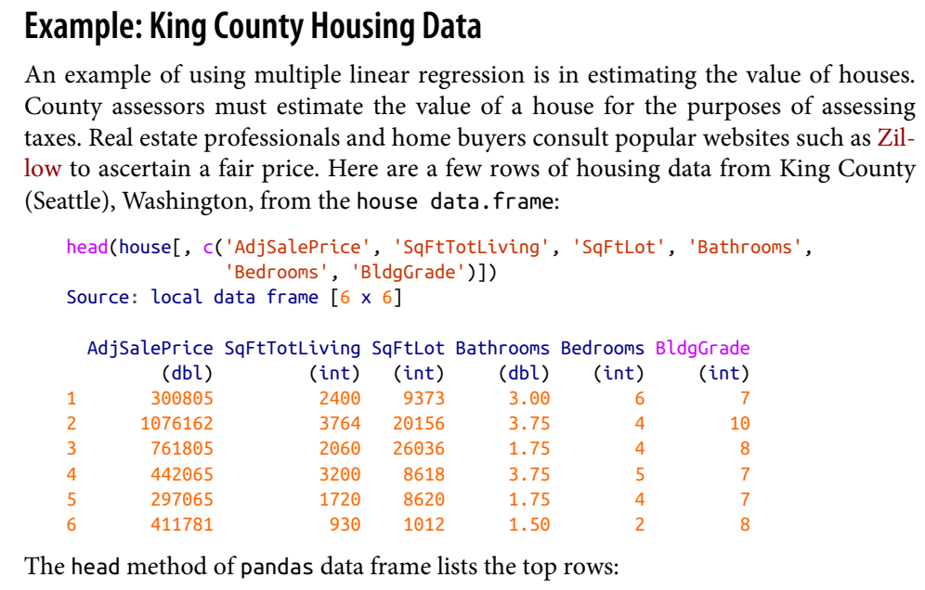
Multiple Linear Regression

Slide 23
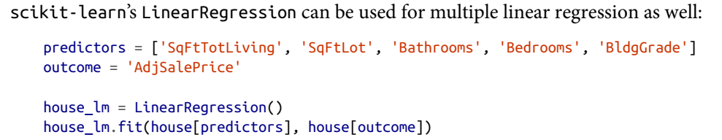
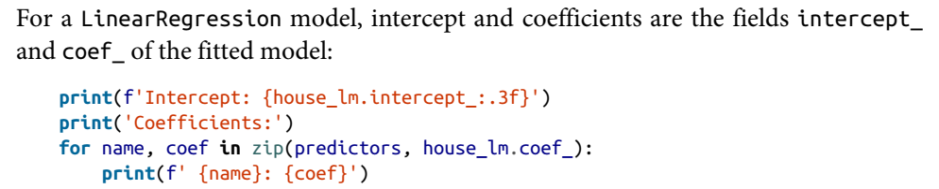
Multiple Linear Regression
The goal is to predict the sales price from the other variables.

Slide 24
Multiple Linear Regression
In Multiple regression the interpretation of the coefficients is same as simple linear regression:
the predicted value Y changes by the coefficient bj for each unit change in Xj assuming all the other variables, Xk for k ≠ j, remain the same.
  For example, adding an extra finished square foot to a house increases the estimated value by roughly $229; adding 1,000 finished square feet implies the value will increase by $228,800.

Slide 25
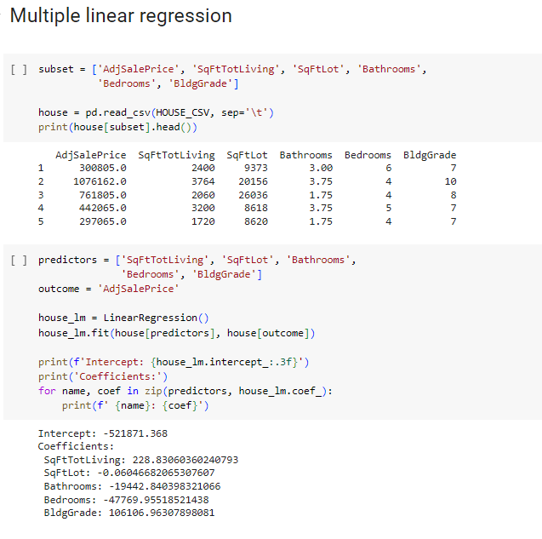

Slide 26
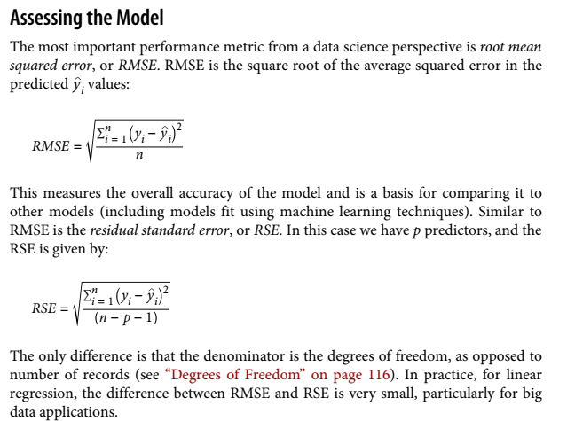
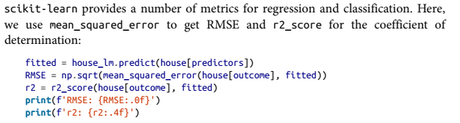

Slide 27
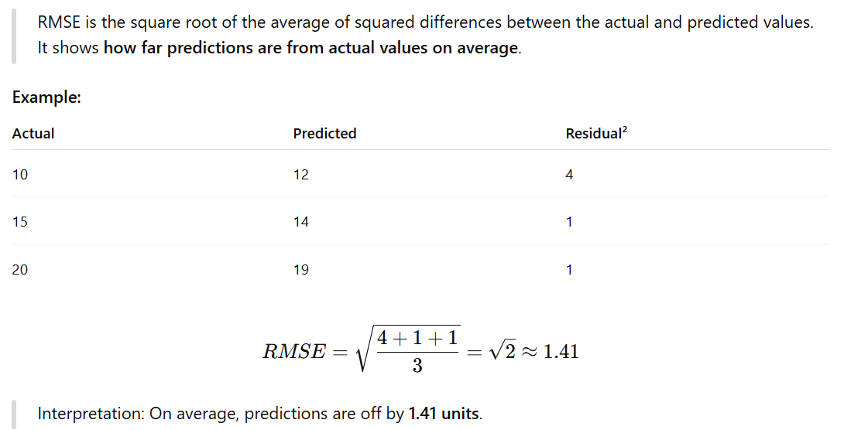
RMSE (Root Mean Squared Error)

Slide 28
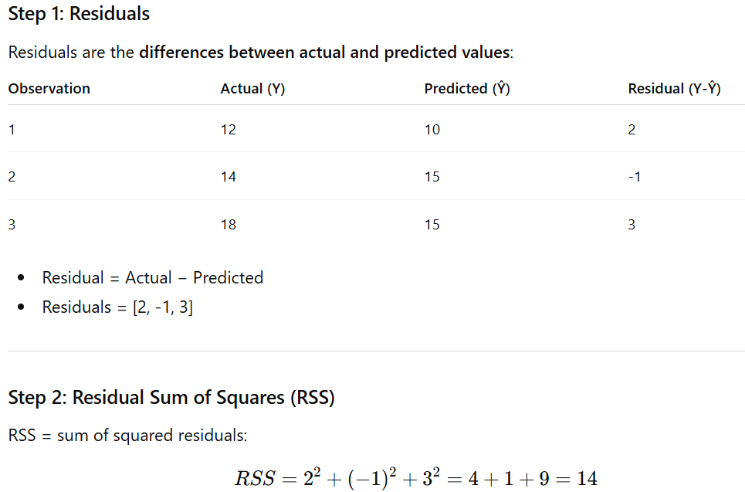
RSE (Residual Standard Error)
RSE is the standard deviation of the residuals, adjusted for the number of predictors.
It measures the typical size of the residuals after considering all features

Slide 29
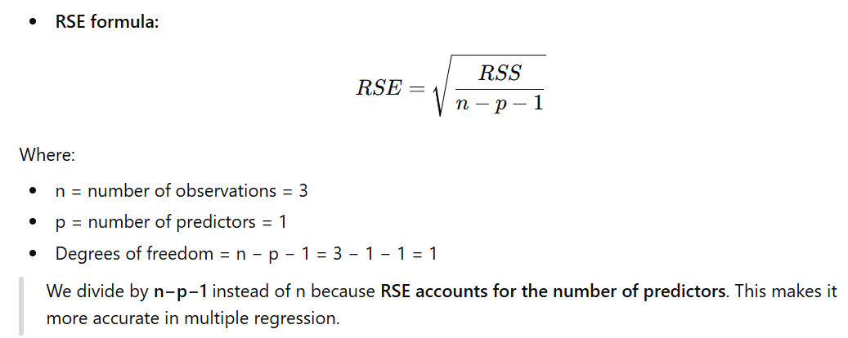
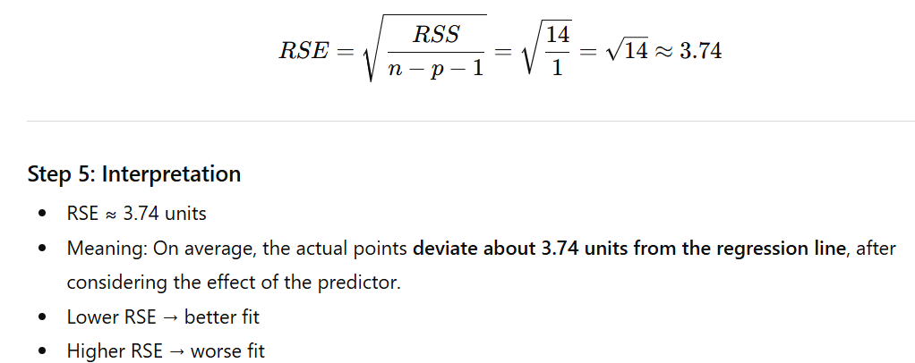

Slide 30
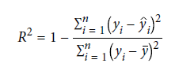
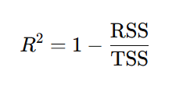
Multiple Linear Regression
Another useful metric that you will see in software output is the coefficient of determination, also called the R-squared statistic or R2. R-squared ranges from 0 to 1.
R² = 1 → perfect fit, all points lie on the regression line.
R² = 0 → the model does not explain any variability, same as using the mean as prediction.
It measures the proportion of variation in the data that is accounted for in the model.
It is useful mainly in explanatory uses of regression where you want to assess how well the model fits the data. The formula for R2 is:
Notes:
RSS (Residual Sum of Squares) = sum of squared differences between actual and predicted values.
TSS (Total Sum of Squares) = sum of squared differences between actual values and the mean.
R² tells us the proportion of variability in the output (y) that the model can explain.

Slide 31
Cross-Validation
Classic statistical regression metrics (R2, F-statistics, and p-values) are all “in-sample” metrics they are applied to the same data that was used to fit the model.
It would make a lot of sense to set aside some of the original data, not use it to fit the model, and then apply the model to the set-aside (holdout) data to see how well it does.
Normally, you would use a majority of the data to fit the model and use a smaller portion to test the model.
Cross-validation extends the idea of a holdout sample to multiple sequential holdout samples.
The division of the data into the training sample and the holdout sample is also called a fold.
The algorithm for basic k-fold cross-validation is as follows:
  Set aside 1/k of the data as a holdout sample.
  Train the model on the remaining data.
  Apply (score) the model to the 1/k holdout, and record needed model assessment metrics.
  Restore the first 1/k of the data, and set aside the next 1/k (excluding any records that got picked the first time).
  Repeat steps 2 and 3.
  Repeat until each record has been used in the holdout portion.
  Average or otherwise combine the model assessment metrics

Slide 32
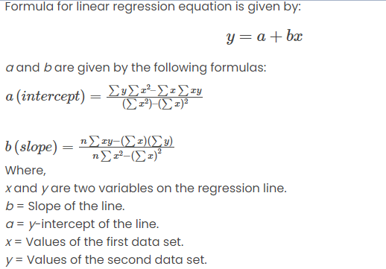
Regression Example (Paper pencil)

Slide 33
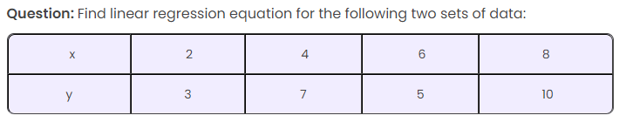
Regression Example (Paper pencil)

Slide 34
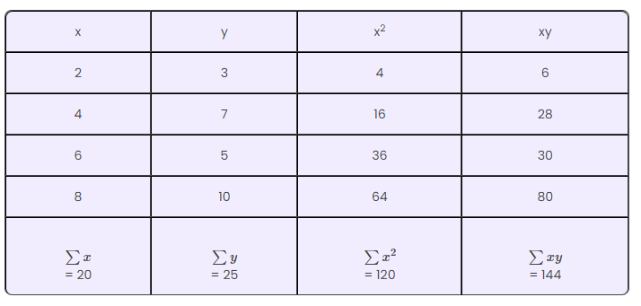
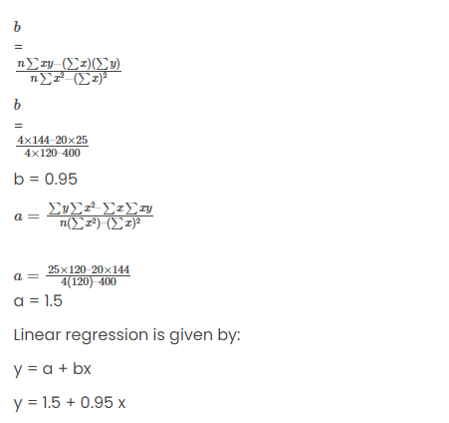
Regression Example (Paper pencil)

